Slide 1


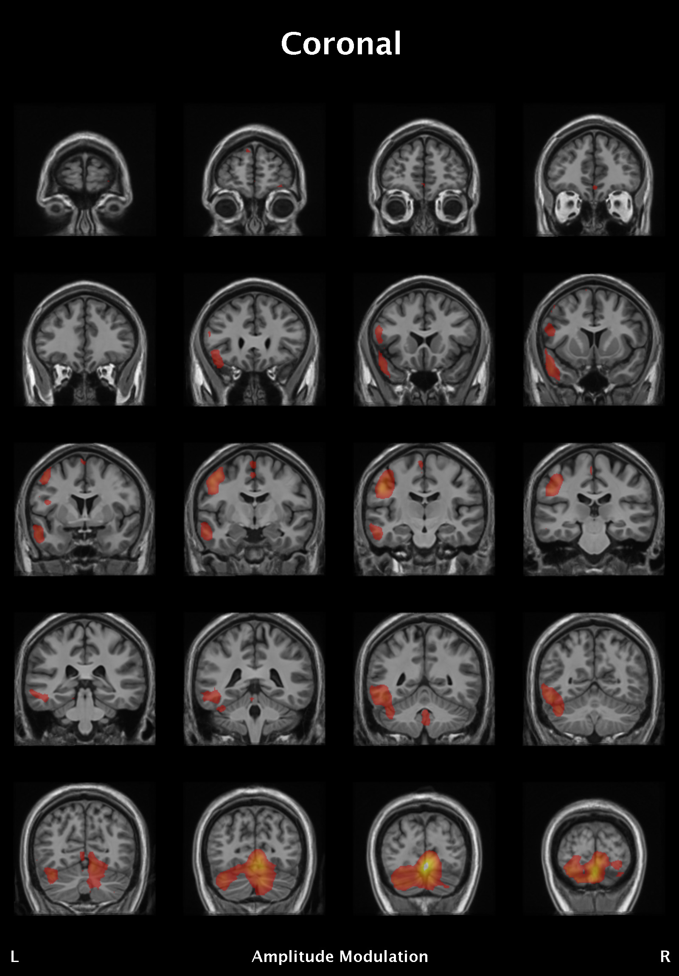
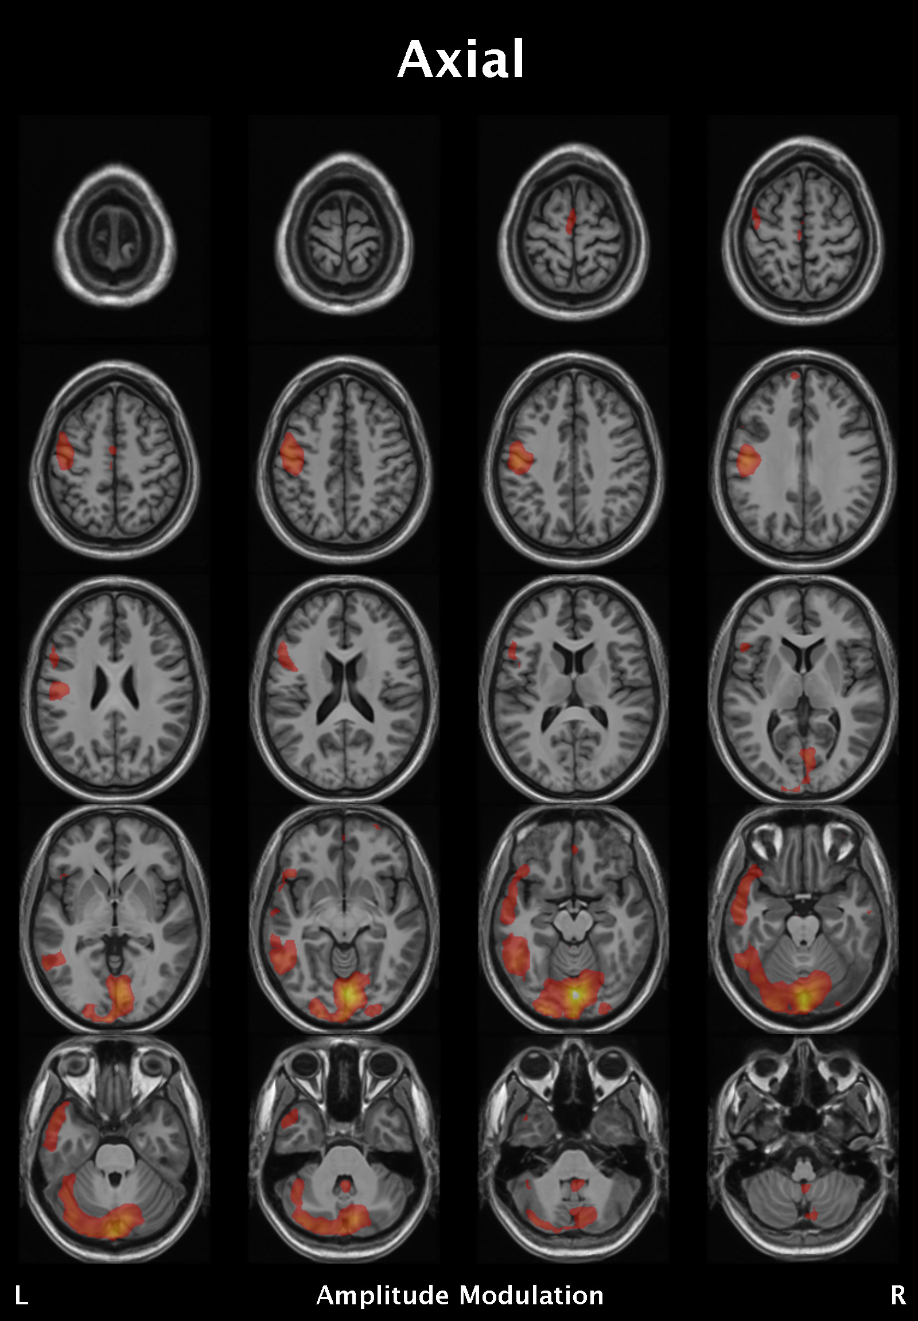
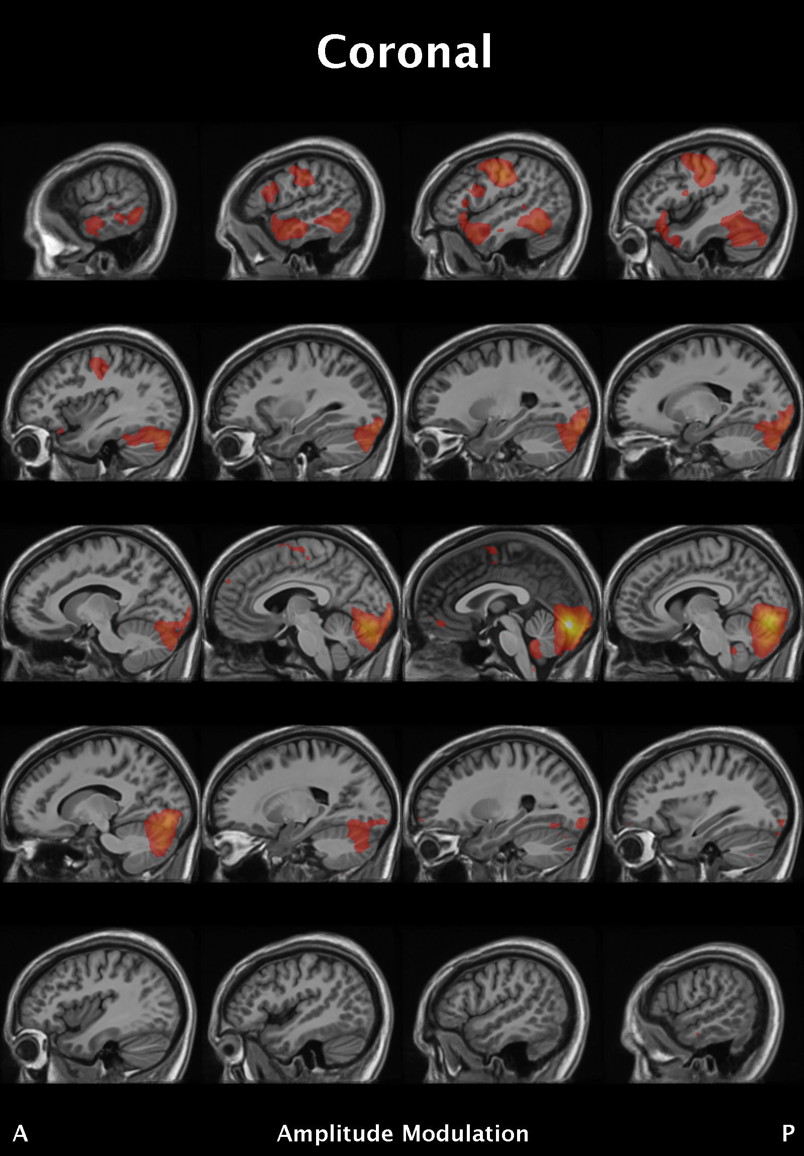
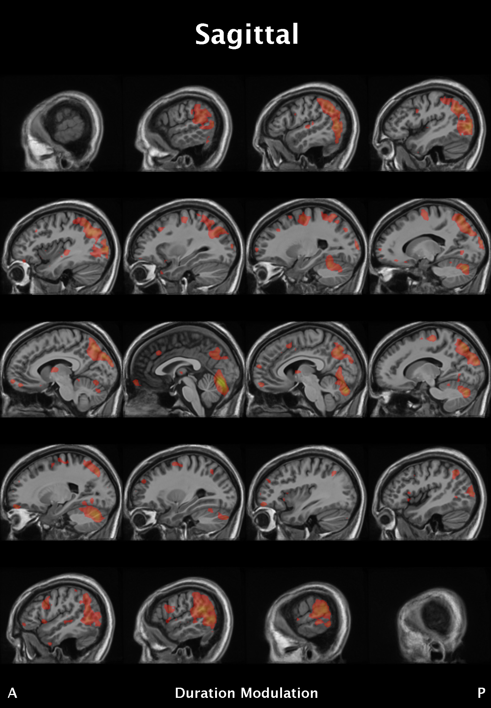
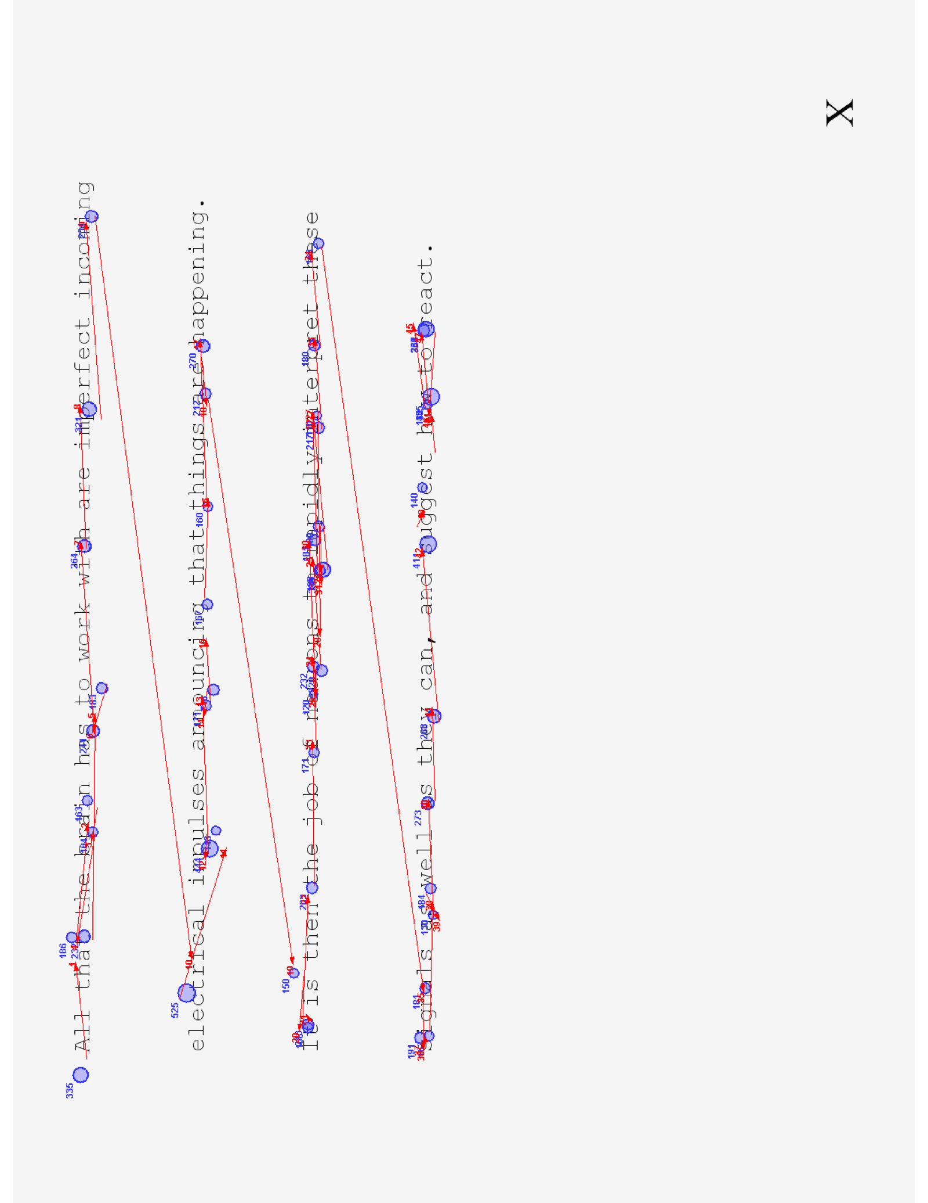
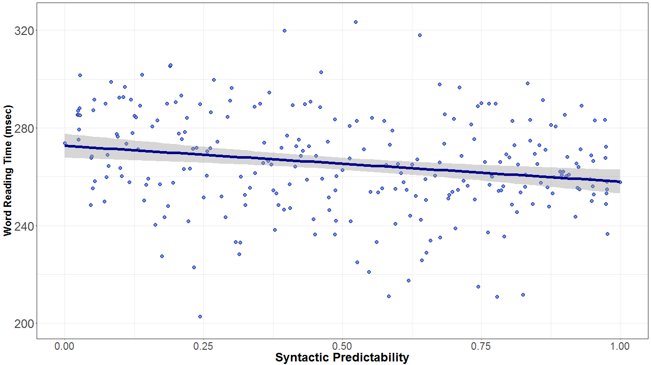
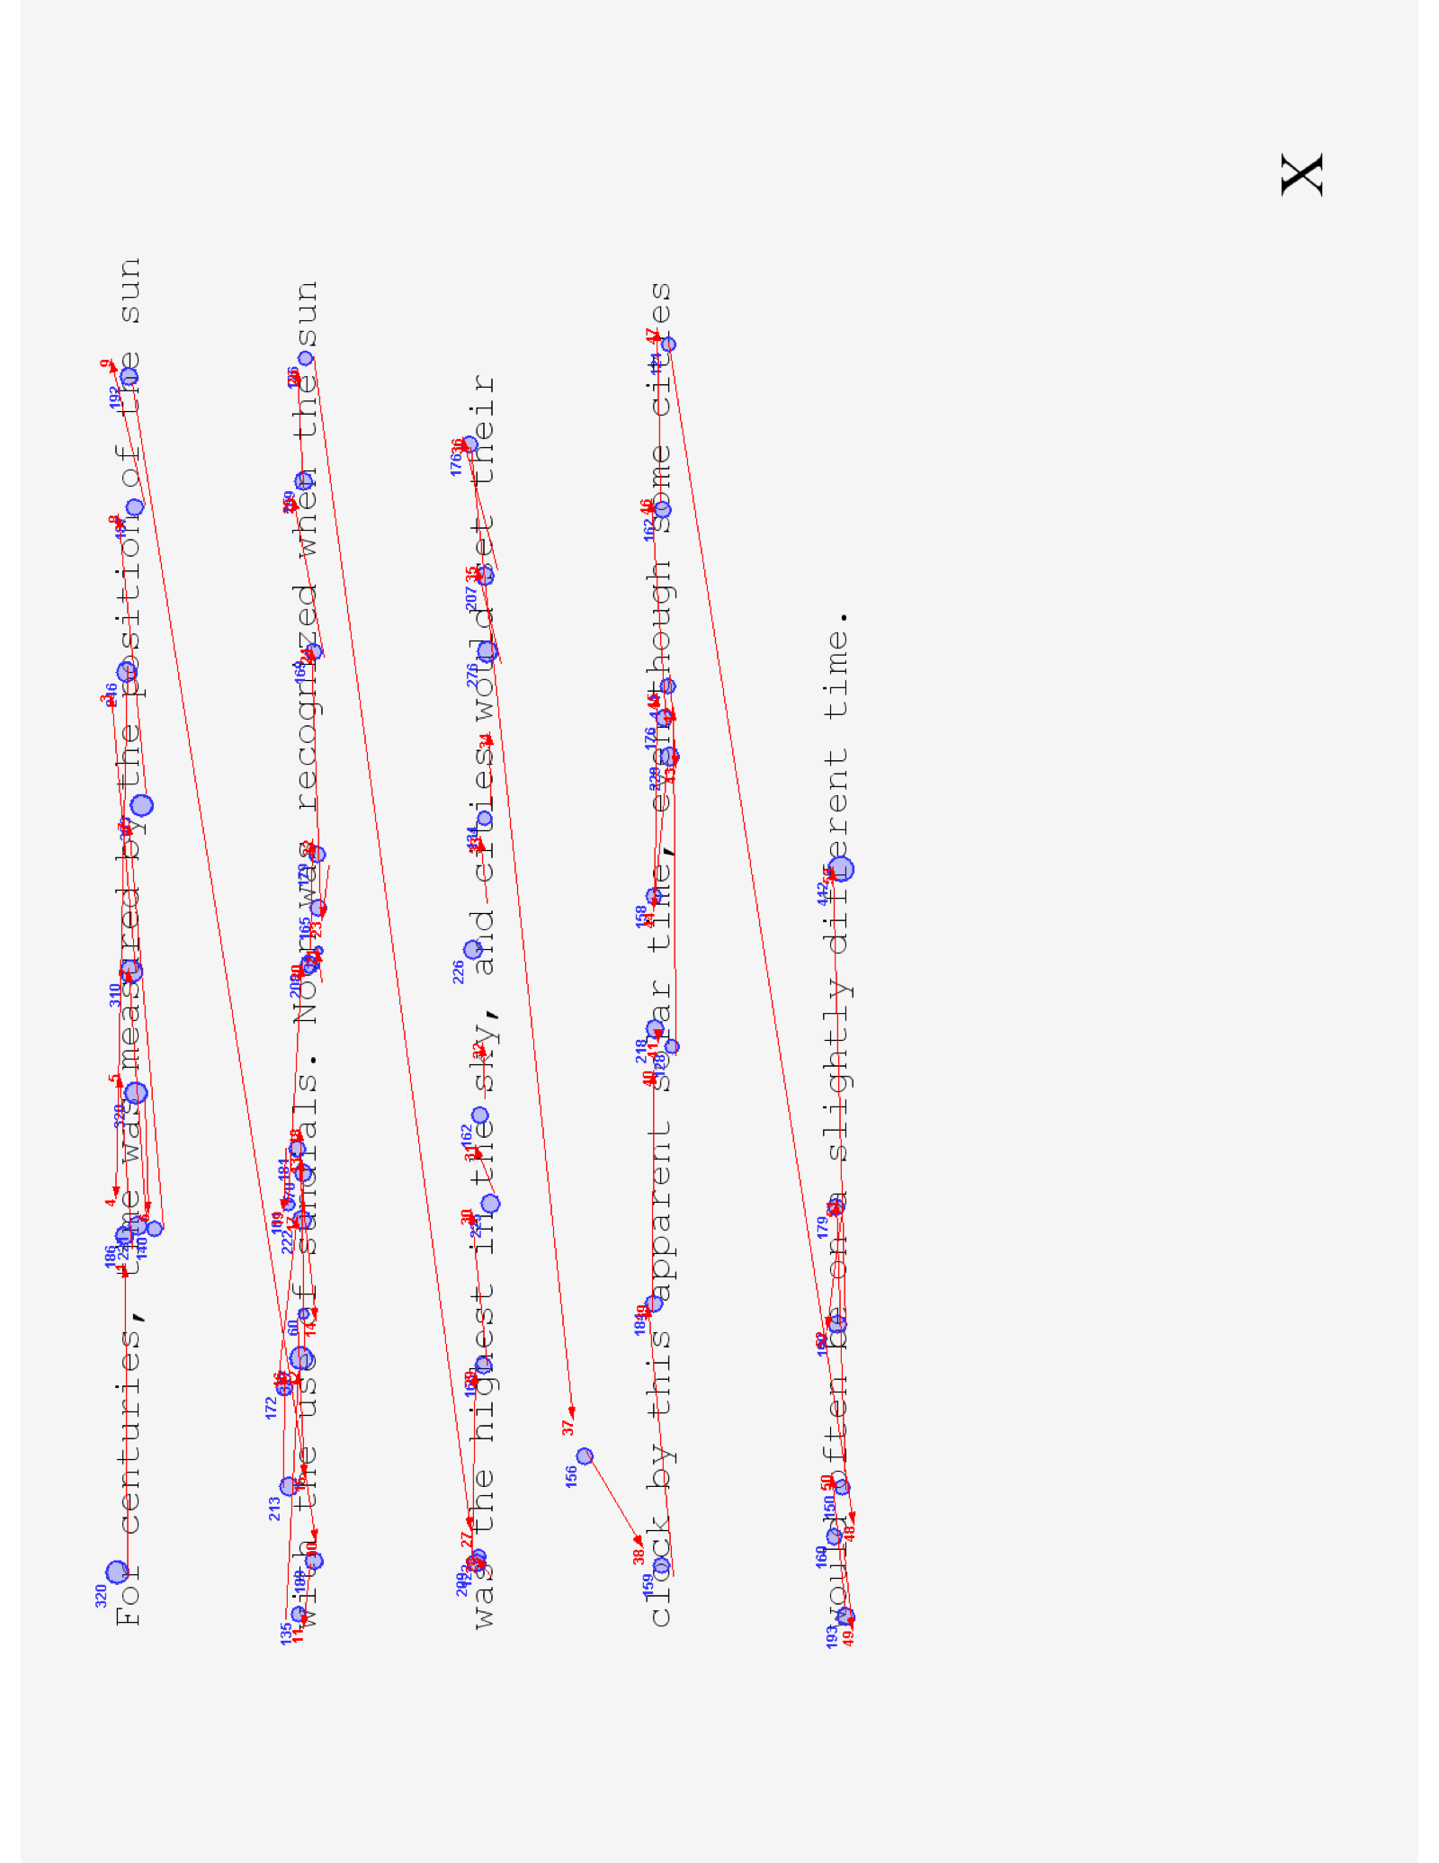
Fixation-Related fMRI and Syntactic Networks in the Brain
Brent Foster, Ben Carter, Steven Luke, Ph.D.
Department of Neuroscience
INTRODUCTION
Humans comprehend language at varying levels of complexity. Syntax, in particular, deals with the arrangement of words and phrases into meaningful sentences. For instance, in English we expect most sentences to follow some variation of the order “Subject–Verb–Object” such as “The boy (Subject) ate (Verb) cake (Object).” On the surface, such grammatical rules seem simple. However, our understanding of how the brain implements these rules to understand sentences is incomplete.
Syntax appears to be associated with Broca’s area in the frontal lobe and various regions of the left temporal lobe¹. However, recent research has provided controversial data suggesting that the viewpoint of a specific “syntactic center” of the brain is oversimplified. In fact, when processing syntax, the brain appears to activate multiple areas not specific to syntactic tasks alone². The primary purpose of this study was to determine the network for neural syntactic processing via fixation-related fMRI and syntactic predictability.
METHODOLOGY
Reading passages were selected and standardized from sources such as newspaper articles and classic children’s literature. Every word was given a predictability value according to context. Data was collected from 44 participants (18 females), ages ranging from 18 to 25. Eye movements were recorded via an SR Research Eyelink 1000+ eye-tracker. Functional and structural brain scans were recorded with a Siemens Trio 3T MRI machine housed in the BYU MRI research facility on campus. MRI scans were analyzed with AFNI and ANTs.
RESULTS
RESULTS (CONT’D)
BOLD signals correlated with syntactic predictability were in:
Visual Cortex, involved in processing visual information.
Frontal and Supplementary Eye Fields, which control where we look
Left Inferior Frontal Gyrus (which contains Broca’s Area), a region commonly implicated in syntactic processing, and
Left Superior Temporal Gyrus, a region involved in language processing in general and syntax specifically.
DISCUSSION
These results corroborate previous findings from research studying syntactic processing¹. Our next steps will involve exploring the structural and functional connectivity of these regions with each other and with other regions of the eye movement network, to better understand how syntactic predictability influences how we read.
This research is important in helping us understand how syntax rules are implemented in the human brain. Such an understanding is beneficial for both health practitioners and researchers in language acquisition and learning. Once the syntactic network is understood, doctors and speech pathologists can better identify problem areas in the brains of patients with various language deficits ranging from dyslexia to language-specific aphasias (caused by strokes, traumatic brain injuries, or other neural tissue damage). This research could also clarify how second-language learners implement syntax rules that differ from their native language. This could provide valuable information that would enable researchers to improve methods of second-language learning.
Figure 2. BOLD signals during reading tasks correlated with syntactic predictability.
DISCUSSION
SOURCES
Henderson, J. M., Choi, W., Lowder, M. W., & Ferreira, F. (2016, February 22). Language structure in the brain: A fixation-related fMRI study of syntactic surprisal in reading. NeuroImage, (132), 293–299. Retrieved July 18, 2016.
Kaan, E., & Swaab, T. (2002, August 8). The brain circuitry of syntactic comprehension. Trends in Cognitive Science, 6(8), 350–355. Retrieved July 18, 2016.
Figure 3. Word reading times were faster for words that were more syntactically predictable (i.e. readers could better guess what type of word [noun, verb, adjective, preposition] would come next).
Figure 1. Representation of eye movements the reading tasks.

